Slide 1
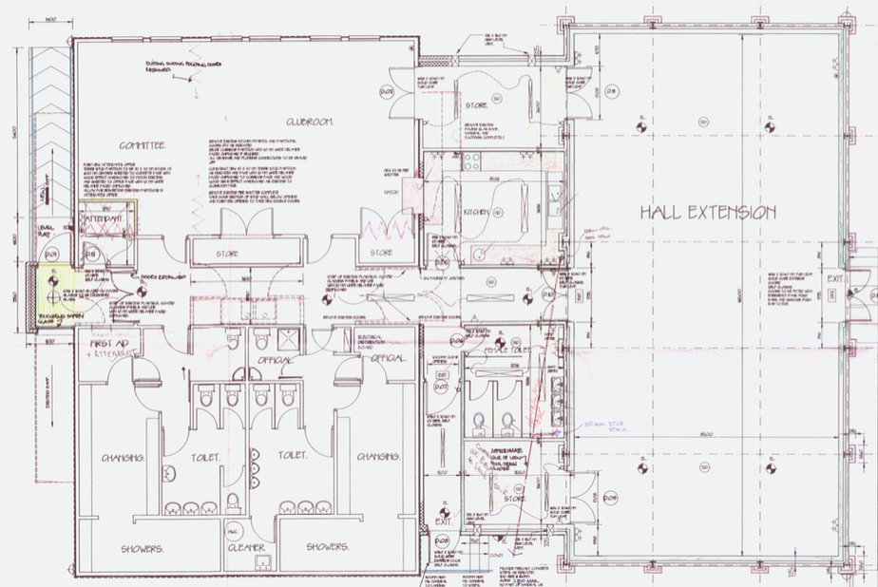

Slide 2
Stage 1
Community garden
Community Café/MeetSpace
store
Kitchen
Workshop
WC

Slide 3
Stage 2
Library
Rooms for incubators, practice room, recording studio
Multiuse space
Community
Kitchen/Cafe
Community garden
MeetSpace
store
Showers
Workshop
WC
Additional Storage

